Slide 1
Control Audit And Security Of
Information System
Units
1 Controls in Information systems
2 Need and methods of auditing Information systems
3 Testing Information systems
4 Security of Information systems
Notes:
By Systems Analysis And Design © V. Rajaraman

Slide 2
Learning Goals
Why controls are necessary in Information systems
Methods of controlling Information systems
How controls are introduced in Information systems
Why Information systems need auditing
How are systems audited
The methods used to test Information systems
How the security of an Information system is ensured

Slide 3
Motivation For Controls
It is very important to ensure the reliability of reports produced by an information system
If unreliability is seen by users the entire credibility of the system is lost
Ensuring reliability is not difficult for small systems but when a system has to handle massive data it is a challenge
Systematic controls are thus essential when a system is designed

Slide 4
Motivation For Audits
Many organizations are now entirely dependent on computer based information system
These information systems contain financial data and other critical procedures
It is essential to protect the systems against frauds and ensure that sound accounting practices are followed
It is necessary to trace the origin and fix responsibilities when frauds occur
Audit methods primary purpose is to ensure this.

Slide 5
Motivation For Testing
Systems contain many individual subsystems
Usually sub-systems and programs are individually tested
However when a whole system is integrated unforeseen errors may be seen
Thus before releasing a system the entire operational system should be tested for correctness and completeness

Slide 6
Motivation For Security
Systems contain sensitive data about the organization and also about persons working in the organization
Sensitive data should be protected from spies, thieves or disgruntled employees.
Thus access should be carefully controlled and provided only on a need to know basis
When computers are networked corruption may take place due to viruses
Services may be disrupted due to denial of service attacks
Thus systems should be designed with appropriate security measures.

Slide 7
Motivation For Disaster Recovery
Organizations depend on Information systems for their entire operations
It is thus essential to ensure continuity of service when unforeseen situations such as disk crashes,fires,floods and such disasters take place.
Thus it is essential to ensure quick recovery from disasters and ensure continuity of service.

Slide 8
Control Audit and Security of Information
System
CONTROL- Method to ensure that a system processes data as per design and that all data is included and are correct
AUDIT AND TESTING - Ensure that the system is built as per specifications and that processed results are correct. Protect systems from frauds.
SECURITY- Protection of data resources, programs, and equipment from illegal use, theft, vandalism, accidents, disasters etc.

Slide 9
Need Of Controls
• Information systems handle massive amounts of data – accidents such as not including some data can cause serious damage
• Incorrect data entry can lead to high monetary losses
• Credibility in the information system may be lost if errors are found in operational systems

Slide 10
Objectives Of Controls
•To make sure data entering the computer are correct
•Check clerical handling of data before it is input to a computer
•Provide means of detecting and tracing errors which occur due to bad data or bad program
•Ensure legal requirements are met
•To guard against frauds

Slide 11
Control Techniques
ORGANIZATIONAL MEASURES
Well defined responsibility for input preparation, delivery output use, operation and maintenance
- Changes in program and data (if any) should be
documented
- Performance of task and recording must be
by different persons to prevent frauds

Slide 12
Control Techniques
INPUT PREPARATION CONTROL
-Sequence numbering
-Batch controls
-Data entry and verification
-Record totals
-Self checking digits

Slide 13
Auditing Technology for Information Systems
A. Review of Systems Documentation
B. Test Data
C. Integrated-Test-Facility (ITF) Approach
D. Parallel Simulation
E. Audit Software
F. Embedded Audit Routines
G. Mapping
H. Extended Records and Snapshots

Slide 14
A. Review of Systems Documentation
The auditor reviews documentation such as narrative descriptions, flowcharts, and program listings. In desk checking the auditor processes test or real data through the program logic.

Slide 15
B. Test Data
The auditor prepares input containing both valid and invalid data. Prior to processing the test data, the input is manually processed to determine what the output should look like. The auditor then compares the computer-processed output with the manually processed results.

Slide 16
Illustration of Test Data Approach
Computer Operations
Auditors
Prepare Test
Transactions
And Results
Transaction
Test Data
Computer
Application
System
Computer
Output
Manually
Processed
Results
Auditor Compares

Slide 17
C. Integrated Test Facility (ITF) Approach
A common form of an ITF is as follows:
A dummy ITF center is created for the auditors.
Auditors create transactions for controls they want to test.
Working papers are created to show expected results from manually processed information.
Auditor transactions are run with actual transactions.
Auditors compare ITF results to working papers.

Slide 18
Illustration of ITF Approach
Computer Operations
Auditors
Actual
Transactions
ITF
Transactions
Prepare ITF
Transactions
And Results
Computer
Application
System
Data Files
ITF Data
Reports
With Only
Actual Data
Reports
With Only
ITF Data
Manually
Processed
Results
Auditor
Compares

Slide 19
D. Parallel Simulation
The test data and ITF methods both process test data through real programs. With parallel simulation, the auditor processes real client data on an audit program similar to some aspect of the client’s program. The auditor compares the results of this processing with the results of the processing done by the client’s program.

Slide 20
Illustration of Parallel Simulation
Computer Operations
Auditors
Actual
Transactions
Computer
Application
System
Auditor’s
Simulation
Program
Actual Client
Report
Auditor Compares
Auditor
Simulation
Report

Slide 21
E. Audit Software
Computer programs that permit computers to be used as auditing tools include:
1. Generalized audit software
Perform tasks such as selecting sample data from file, checking computations, and searching files for unusual items.
2. P.C. Software
Allows auditors to analyze data from notebook computers in the field.

Slide 22
F. Embedded Audit Routines
1. In-line Code – Application program performs
audit data collection while it processes data for normal production purposes.
2. System Control Audit
Review File (SCARF)–
Edit tests for audit
transaction analysis are
included in program.
Exceptions are written
to a file for audit review.
The Auditor

Slide 23
What is Security?
“The quality or state of being secure—to be free from danger”
A successful organization should have multiple layers of security in place:
Physical security
Personal security
Operations security
Communications security
Network security
Information security
Notes:
What Is Security?
In general, security is “the quality or state of being secure--to be free from danger.”
It means to be protected from adversaries--from those who would do harm, intentionally or otherwise.
What Is Security?
A successful organization should have the following multiple layers of security in place for the protection of its operations:
Physical security - to protect the physical items, objects, or areas of an organization from unauthorized access and misuse.
Personal security – to protect the individual or group of individuals who are authorized to access the organization and its operations.
Operations security – to protect the details of a particular operation or series of activities.
Communications security – to protect an organization’s communications media, technology, and content.
Network security – to protect networking components, connections, and contents.

Slide 24
Types of Security
Physical Security: To Protect physical items, object or areas
Personal Security: To protect the individual or group of individuals who are authorized
Operation Security: To protect the details of a particular operation or activities.

Slide 25
Types of Security
Communication Security: To protect communication media, technology and content
Network Security: To protect networking components, connections and contents
Information Security: To protect information assets

Slide 26
What is Information Security?
The protection of information and its critical elements, including systems and hardware that use, store, and transmit that information
Necessary tools: policy, awareness, training, education, technology
C.I.A. triangle was standard based on confidentiality, integrity, and availability
C.I.A. triangle now expanded into list of critical characteristics of information
Notes:
What Is Information Security?
Information security, therefore, is the protection of information and its critical elements, including the systems and hardware that use, store, and transmit that information.
But to protect the information and its related systems from danger, tools, such as policy, awareness, training, education, and technology are necessary.
The C.I.A. triangle has been considered the industry standard for computer security since the development of the mainframe.
It was solely based on three characteristics that described the utility of information: confidentiality, integrity, and availability.
The C.I.A. triangle has expanded into a list of critical characteristics of information.

Slide 27
CIA triangle “Security triad”
Confidentiality: Making sure that those who should not see information
Integrity: Making sure that the information hasn’t been changed from it’s original
Availability: Making sure that the information is available for use when you need it.

Slide 28
Information Security C.I.A triangle
Data and information is classified into different levels of confidentiality to ensure that only authorized users access the information
System is available at all times only for authorizes and authenticated persons.
System is protected from being shut down due to external or internal threats or attacks
Confidentiality
Availability
Information Security
Integrity
Data and information is accurate and protected from tampering by unauthorized persons.
Data and information is consistent and validated.

Slide 29
Critical Characteristics of Information
The value of information comes from the characteristics it possesses:
Availability
Accuracy
Authenticity
Confidentiality
Integrity
Utility
Possession
Notes:
Critical Characteristics of Information
The value of information comes from the characteristics it possesses.
Availability - enables users who need to access information to do so without interference or obstruction and in the required format. The information is said to be available to an authorized user when and where needed and in the correct format.
Accuracy- free from mistake or error and having the value that the end-user expects. If information contains a value different from the user’s expectations due to the intentional or unintentional modification of its content, it is no longer accurate.
Authenticity - the quality or state of being genuine or original, rather than a reproduction or fabrication. Information is authentic when it is the information that was originally created, placed, stored, or transferred.
Confidentiality - the quality or state of preventing disclosure or exposure to unauthorized individuals or systems.
Integrity - the quality or state of being whole, complete, and uncorrupted. The integrity of information is threatened when the information is exposed to corruption, damage, destruction, or other disruption of its authentic state.
Utility - the quality or state of having value for some purpose or end. Information has value when it serves a particular purpose. This means that if information is available, but not in a format meaningful to the end-user, it is not useful.
Possession - the quality or state of having ownership or control of some object or item. Information is said to be in possession if one obtains it, independent of format or other characteristic. While a breach of confidentiality always results in a breach of possession, a breach of possession does not always result in a breach of confidentiality.

Slide 30
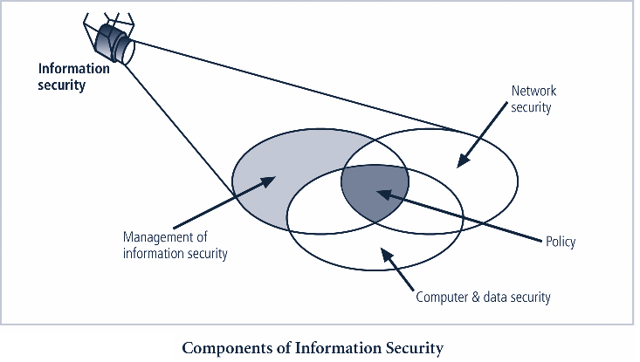
Notes:
Components of Information Security

Slide 31
Securing Components
Computer can be subject of an attack and/or the object of an attack
When the subject of an attack, computer is used as an active tool to conduct attack
When the object of an attack, computer is the entity being attacked
Notes:
Securing The Components
When considering the security of information systems components, it is important to understand the concept of the computer as the subject of an attack as opposed to the computer as the object of an attack.
When a computer is the subject of an attack, it is used as an active tool to conduct the attack. When a computer is the object of an attack, it is the entity being attacked.

Slide 32
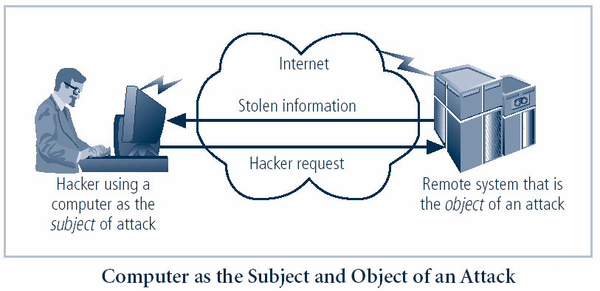
Figure 1-5 – Subject and Object of Attack
Notes:
It is important to note that the same computer can be both the subject and object of an attack, especially in multi-user systems.

Slide 33
A Final Word
Treat your password like you treat your toothbrush. Never give it to anyone else to use, and change it every few months.

Slide 34
LAYERED SECURITY
Layered security, in its simplest form, consists of stacking security solutions, one on top of the other, to protect a computer from current, and zero day malware attacks.
Malware: It refers to software programs designed to damage or do other unwanted actions on a computer system.
Examples of malware include viruses, worms, trojan horses and spyware.

Slide 35
Why do we need it?
To providing adequate computer system protection.
Gaps exist in protection capabilities in even the most sophisticated security applications.

Slide 36
A CONSUMER LAYERED SECURITY APPROACH
Backup: Consider where you would be if your layered security strategy failed. If you’ve ever lost critical data to a malware infection, no doubt you already consider it of primary importance.
Free backup utilities are readily available
Hard Drive Cloning is Easy with Free Ease us Disk Copy
Free Drive Image XML- the best way to backup data

Slide 37
Consumer Layered
Firewall – is an application, or a hardware appliance, designed to block unauthorized access to your computer from the Internet, at the same time permitting authorized communications.
Antimalware – A front line antimalware application is absolutely critical to avoid system infection.
For free antimalware click “Tech Thoughts Top & Free antimalware application”

Slide 38
Consumer Layered
Antivirus – An antivirus application is another critical component in a layered defense strategy to ensure that if a malicious program is detected, it will be stopped dead in its tracks!
Web Browser Security – Install a free Internet Browser add-on such as WOT(Web of Trust). WOT tests web sites you are visiting for spyware, spam, viruses, browser exploits, unreliable online shops, phishing, and online scams, helping you avoid unsafe web sites.

Slide 39
Enterprise Layered Security
A modern enterprise security strategy uses a layered identity approach as the underpinning of its security.
All enterprise systems, applications, information systems, facilities, buildings and rooms are assigned as enterprise risk.
As the user digitally or physically approaches higher risk applications or a physical location the stronger authentication is used.
As consider the enterprise firewall and the use of Id and passwords for login.
Notes:
Underpinning: at the bottom of

Slide 40
Implementing a Layered Identity Strategy: Enterprise Layered
This could take the form of digital certificates, security tokens, smart cards and biometrics. It could also take the form of transactional security.
While the user may successfully use their Id and password, the transaction security software would examine the IP address that the user is coming in from, their geographic position, the time of day, the type of physical computer the user is using and their behavioral pattern.
If any of these differ from the past, then system alarm bells may start ringing resulting in the user being asked more personal questions, the action being stopped.

Slide 41
Extended Validation (EV) Certificate
An extended validation (EV) certificate is a data security or anti-fraud measure recommended in 2006 by the Certificate Authority Browser Forum.
Certificate Authority/Browser Forum (CAB Forum): An open voluntary association of certification authorities and software developers.
The first version of the Extended Validation SSL Certificate Guidelines was ratifed in June 2007.
The EV identity verification process requires the applicant to prove exclusive rights to use a domain, confirm its legal, operational and physical existence, and prove the entity has authorized the assurance of the Certificate.
Notes:
EV Certificates provide a higher level of validation and are available to all business and government entities, but are not available to individuals. The EV process is more rigorous and detailed than for any other Certificate and will require additional steps, which may include obtaining signatures from several people within the applying company, legal verification of the business's existence, etc.
An extended validation (EV) certificate is a data security/anti-fraud measure recommended in 2006 by the Certificate Authority/Browser Forum (CAB Forum): an open voluntary association of certification authorities and software developers.
The first version of the Extended Validation SSL Certificate Guidelines was ratified in June 2007.
Purpose
The forum has recommended the introduction of a new security measure primarily to combatphishing: websites that mimic legitimate websites to harvest personal information including credit card numbers and bank account access details.
(a) Primary Purposes The primary purposes of an EV Certificate are to:
(1) Identify the legal entity that controls a website Provide a reasonable assurance to the user of an Internet browser that the website the user is accessing is controlled by a specific legal entity identified in the EV Certificate by name, address of Place of Business, Jurisdiction of Incorporation or Registration and Registration Number or other disambiguating information; and (2) Enable encrypted communications with a website Facilitate the exchange of encryption keys in order to enable the encrypted communication of information over the Internet between the user of an Internet browser and a website. SOURCE: EXTENDED VALIDATION SSL CERTIFICATE GUIDELINES

Slide 42
Extended Validation (EV) Certificate
EV Certificates provide a higher level of validation and are available to all business and government entities, but are not available to individuals.
The EV process is more rigorous and detailed than for any other Certificate and will require additional steps, which may include obtaining signatures from several people within the applying company, legal verification of the business's existence, etc.

Slide 43
The primary purposes of an EV Certificate
To identify the legal entity that controls a website which provide a reasonable assurance to the user of an Internet browser that the website which the user is accessing is controlled by a specific legal entity identified in the EV Certificate by name, address of Place of Business, and Registration Number.
To enable encrypted communications with a website which facilitate the exchange of encryption keys in order to enable the encrypted communication of information over the Internet between the user of an Internet browser and a website.

Slide 44
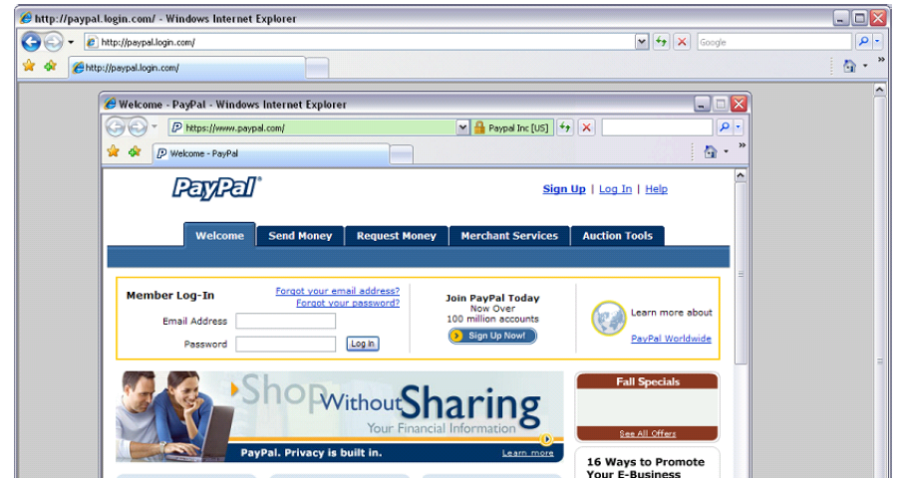
Designed for Banks and Large E-commerce sites

Slide 45
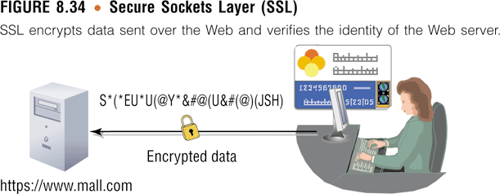
SSL Certificate
Secure Sockets Layer (SSL)
Digital certificates combined allows for encrypted communications to occur between Web browser and Web server

Slide 46
What is SSL Certificate?
SSL (Secure Sockets Layer) is the transaction security protocol used by websites to protect online communications.
The most common use of SSL is to provide protection for confidential data, such as personal details or credit card information, entered into a website.
Ecommerce security cannot be an after-thought in your business plans. Today's online shoppers look for the visual cues provided by SSL Certificates, such as the closed padlock and the “https”.
Notes:
SSL (Secure Sockets Layer) is the transaction security protocol used by websites to protect online communications. The most common use of SSL is to provide protection for confidential data, such as personal details or credit card information, entered into a website.
Online security is essential to conducting business online — and it's foremost in the minds of your customers. Because virtually anyone can build a website and offer products for sale online, customers may wonder why they should trust your website. Whether your site accepts online payments or collects customer information via forms, taking steps to show your visitors that your site is legitimate and safe is vital to the success of your business.
Ecommerce security cannot be an after-thought in your business plans. Today's savvy online shoppers look for the visual cues provided by SSL Certificates, such as the closed padlock and the "https". If you've taken the time to build a website you'll want to ensure it's always available and free from vulnerabilities with the site monitoring service. Providing the appropriate website security instills confidence and trust, improves your visitor's experience, and keeps them coming back — ultimately increasing sales both online and off.
SSL (Secure Sockets Layer) is the transaction security protocol used by websites to protect online communications. The most common use of SSL is to provide protection for confidential data, such as personal details or credit card information, entered into a website.

Slide 47
Extended Validation SSL Certificate
Show your customers that your site is secure. Our Extended Validation SSL Certificate features our instant verification green address bar, so your customers can easily see that they're protected. Provide your customers with the highest level of online assurance.
When customers see their address bar change to green, they know they can trust your business. That's because the inspection process for an Extended Validation SSL is more extensive than for any other type of security certificate, verifying your organization's identity, the validity of your request and the overall legitimacy of your business.

Slide 48
How can I recognize websites using EV SSL Certificates?
A website using EV SSL Certificate will activate highly visible indicators directly on the browser address bar:
The green address bar, https:// and the padlock icon
The name of the Organization that owns the website and the name of the Certification Authority that issued the EV SSL Certificate.

Slide 49
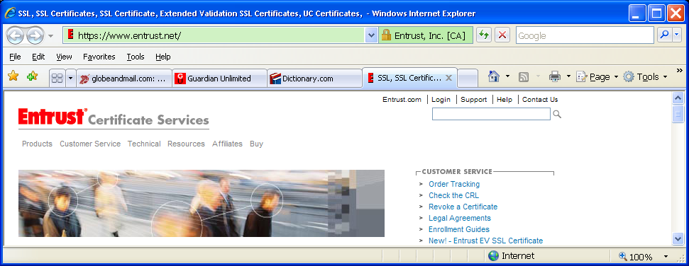
Websites using EV SSL Certificates
Assumed name, registered name and country
alternating with
the issuer’s name
Golden padlock
Green address bar

Slide 50
Remote Access Authentication
Remote access authentication is the process whereby computer users can securely communicate with a network.
A shared theme to all of these methods is the use of a digital certificate that contains information that identifies the user to a server and provides their credentials.
Remote access authentication protocols make it safer to conduct business online as well as use ATMs.

Slide 51
RADIUS
Most modern wireless networks do user authentication using Remote Authentication Dial-In User Service (RADIUS) protocol.
RADIUS handles the overall authentication process of the user's session on the wireless device as well as also handling the authorization and auditing.
The RADIUS system takes the (EAP) Extensible Authentication Protocol Authentication Method, challenges the user with the appropriate authentication method, receives the authentication response and then verifies it.
Notes:
RADIUS
Most modern wireless networks do user authentication using Remote Authentication Dial-In User Service (RADIUS) protocol. RADIUS handles the overall authentication process of the user's session on the wireless device as well as also handling the authorization and auditing. Typically, when you logon to your ISP using a wireless device, you are required to provide authentication information. Often, this uses Extensible Authentication Protocol (EAP). The type of authentication you use is determined by the EAP authentication method. There are many different EAP methods. This can range from the use of an id and password (very insecure), to digital certificates, security tokens and even biometrics. The RADIUS system takes the EAP Authentication Method, challenges the user with the appropriate authentication method, receives the authentication response and then verifies it, often against an enterprise LDAP directory. If the authentication is successful, the RADIUS server will then authorize IP addresses, the tunnelling protocol used to create virtual private networks, etc. Further, the RADIUS server keeps tracks of when a user session begins and ends.

Slide 52
RADIUS
If the authentication is successful, the RADIUS server will then authorize IP addresses, the tunneling protocol used to create virtual private networks.
Further, the RADIUS server keeps tracks of when a user session begins and ends.
For senior executives, who do require quite open access to the applications and information systems via their wireless device.
Issue them with something like a secureID from (Rivest-Shamir-Adleman)RSA one time password generator and have the executives be required to enter this in order to authenticate their wireless device to the network. RSA algorithm
Notes:
The RSA algorithm was invented by Ronald L. Rivest, Adi Shamir, and Leonard Adleman in 1977 and released into the public domain on September 6, 2000.
RSA algorithm (Rivest-Shamir-Adleman)
The RSA algorithm is the most commonly used encryption and authentication algorithm and is included as part of the Webbrowsers from Microsoft and Netscape.
This reduces the risk that the user on the end of the wireless device is not the identity you issued the id and password to.

Slide 53
Policy-based encryption
The Policy Based Encryption gateway automatically encrypts specific emails based on company-defined policies – that is, a set of rules designed to analyze all email, and encrypt any email that matches the pre-defined conditions.
The concept of policy-based encryption is a promising paradigm for trust establishment and authorization in large-scale open environments like the Internet and Mobile Networks.
On policy-based encryption which allow to encrypt a message according to a policy so that only entities fulfilling the policy are able to decrypt the message.
Notes:
The concept of policy-based cryptography is a promising paradigm for trust establishment and authorization in largescale open environments like the Internet and Mobile Networks. It aims at providing a framework for performing cryptographic operations with respect to policies formalized as monotone Boolean expressions written in standard normal forms.
A policy involves conjunctions and disjunctions of conditions where each condition is fulfilled by a digital credential representing the signature of a specific credential issuer on a set of statements about a certain entity. Therefore, an entity fulfills a policy if any only if it has been issued a set of credentials fulfilling the combination of conditions specified by the policy.
In this work, we focus on policy-based encryption schemes which allow to encrypt a message according to a policy so that only entities fulfilling the policy are able to decrypt the message.
More generally, policy-based encryption belongs to an emerging family of encryption schemes sharing the ability to integrate encryption with access control structures.
This ability is mainly enabled by bilinear pairings over elliptic curves and allows for several interesting applications in different contexts.
A policy-based encryption scheme has to fulfill two primary requirements: on one hand, provable security under well defined attack models.
On the other hand, efficiency, especially when dealing with the conjunctions and disjunctions of credential-based conditions.
The contributions of our research work are twofold:
1. The standard acceptable notion of security for public-key encryption schemes is indistinguishability against chosen ciphertext attacks. Hence, it is natural to require that a policy-based encryption scheme also satisfies this strong notion of security. However, the definition of this security notion must be adapted to the policy-based setting. Our first contribution is the definition of policy-oriented security model for policy-based encryption schemes as well as the development of an efficient policy-based encryption scheme that is provably secure under our security model in the random oracle model.
2. Policy-based encryption schemes may suffer from the key-escrow property i.e. in addition to the legitimate holder of the credentials fulfilling the encryption policy, any collusion of credential issuers who are able to issue a set of credentials fulfilling the policy can decrypt the message.
Our second contribution is to address this issue through the notion of policy-based public-key encryption.
The latter allows encrypting a message not only with respect to a policy but also according to a public-key so that only an entity fulfilling the policy and having access to the corresponding private-key is able to decrypt the message.
We developed a policy-based public-key encryption scheme from bilinear pairings and proved its security under the corresponding security model. Our proposal improves related work in terms of both security and efficiency.

Slide 54
Policy-based encryption
More generally, policy-based encryption belongs to an emerging family of encryption schemes sharing the ability to integrate encryption with access control structures.
A policy-based encryption scheme has to fulfill two primary requirements: on one hand, provable security under well defined attack models.
On the other hand, efficiency, especially when dealing with the conjunctions and disjunctions of credential-based conditions.

Slide 55
E-Commerce
Electronic commerce
Systems that support electronically executed business transactions
The fundamental purpose of e-commerce is to execute online transactions
E-commerce is not new; however, recent rapid development of the Internet is surely responsible for the popularity of e-commerce.
The new way of commerce through the Internet creates vast opportunities, but at the same time, it poses challenges.

Slide 56
Types of E-Commerce
Business-to-consumer e-commerce (B2C)
Connects individual consumers with sellers , cutting out the middleman
E.g. Amazon.com
Business-to-business e-commerce (B2B)
Supports business transactions on across private networks, the Internet, and the Web
Consumer-to-consumer e-commerce (C2C)
Connects individual sellers with people shopping for used items
E.g. ebay.com

Slide 57
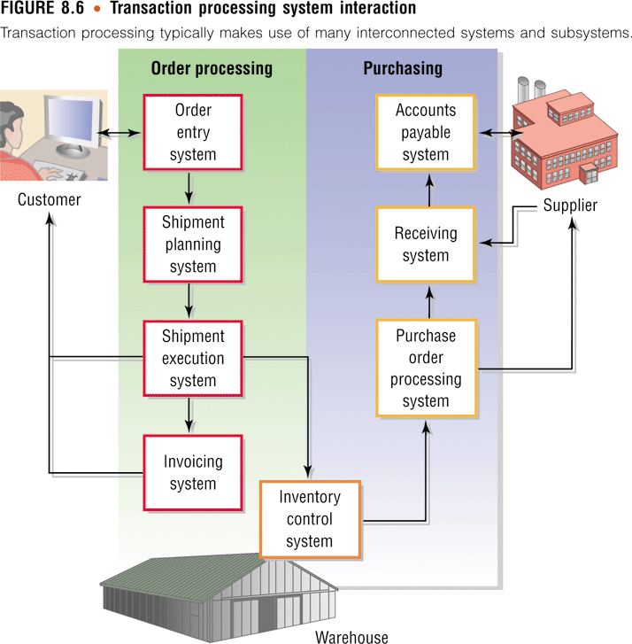
Different Transaction Processing for Different Needs

Slide 58
Thank You

